Slide 1
Magnetic Tracking – Figures

Slide 2
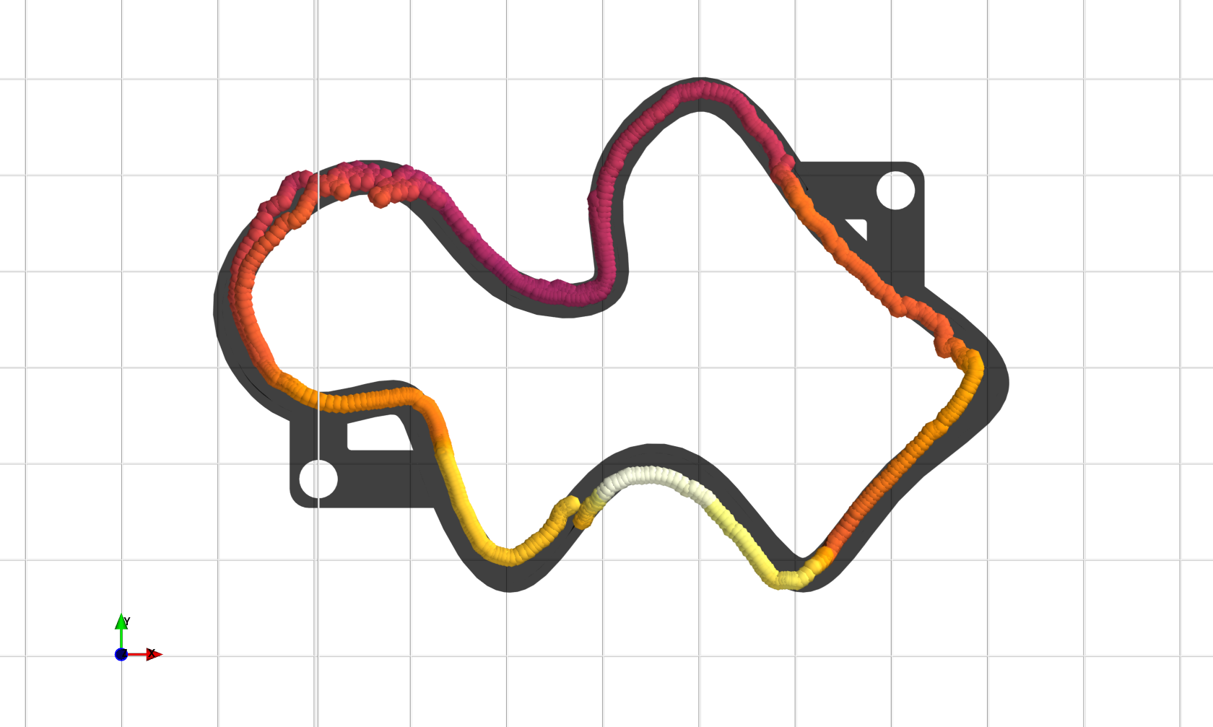
Ø=30 mm
25 mm

Slide 3
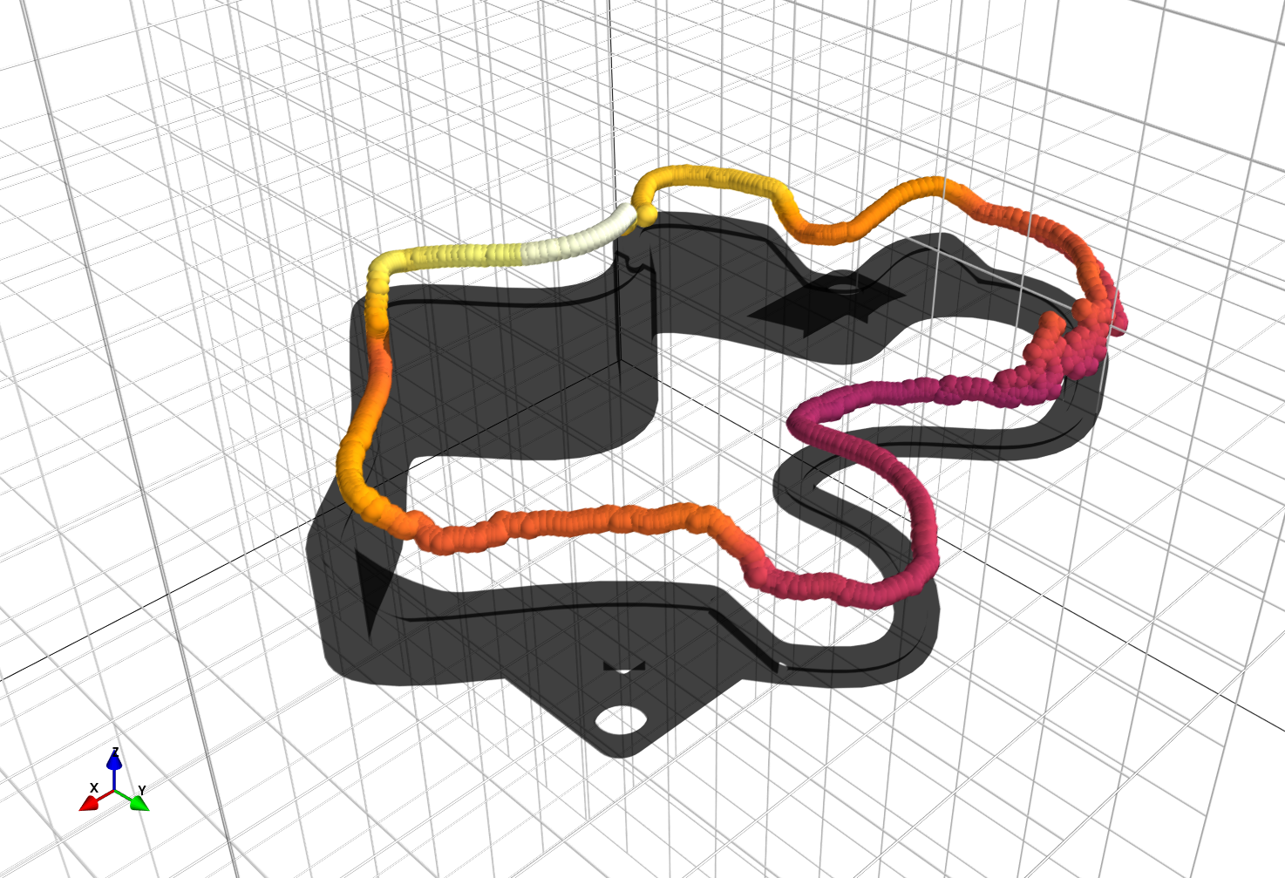

Slide 4
